Slide 1
It’s CPR!: Lyrics
Songs about CPR for KS2 children. Composed by Iain Gilmour
From beginning to end it takes 9mins 23 secs to play/sing all 5 songs!
Put this power point on ‘Slide Show’ (at the top of the tool bar) and start... all you have to do is change the slides at the right time and the correct music will play.
When children listen to the music several times before singing aloud they are more likely to get the melody more accurate. They can teach themselves!
Let the children listen to the music several times first (background music) then:
1. Listen look for repetition (colour backgrounds for verses and choruses)
2. Listen, but sing the choruses in their head (this is called internalising)
3. Sing all of it in their head and identify the harder lines to sing
4. Sing the choruses quietly... still listen to the verses singing in their head
5. Sing all of it quietly
6. Sing a little louder.
*Aim to sing in tune with clear diction, confidence and expression
There are some examples of musical activities if you are interested let me know.

Slide 2
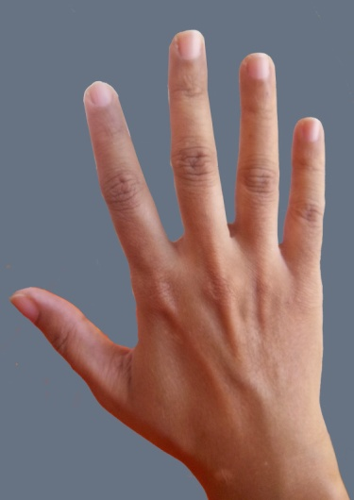
CPR Rap
Verse 1
Look at your hands, all your fingers and thumbs,
They can make a diff’rence when and if the time comes.
If you listen to your training and you keep your head calm,
You might save a life without causing alarm.
Chorus
CPR!
CPR!
Verse 2
Cardiopulmon’ry resuscitation.
Something you can use when in a situation,
When the person on the ground don’t appear to be breathin’
And there’s no response to the hollerin’ and pleadin’
Chorus
CPR!
CPR!

Slide 3
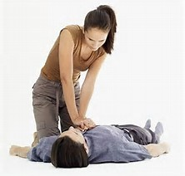
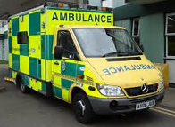
Verse 3
Better get some help, get someone calling 999,
But better be prepared for action meantime.
Lock you hands together and put them in position,
Place them on the chest and manage the condition.
999
Chorus
CPR!
CPR!
Verse 4
Get a good grip that is one you can keep going,
Swap over with a friend if you feel that you are slowing.
There’s not time for a rest, if you do you will regret it,
You can have a rest when you see the paramedic.
Chorus
CPR!
CPR!
CPR!

Slide 4
Heartbeats Heroes
Verse 1
We have the skills, we have the will,
To start a new revolution.
When problems start, with someone's heart,
Trust us, we have the solution.
We know the ins and outs of doing CPR,
If there is trouble then you know just where we are.
Chorus
Heartbeats Heroes,
We're keeping an eye out for you.
Heartbeats Heroes,
We always know what we should do.
Don't despair, if things go wrong,
We'll be there, to help along.
Heartbeats Heroes,
Heroes are working for you.

Slide 5
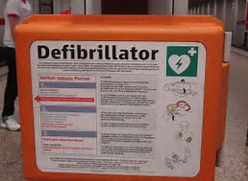
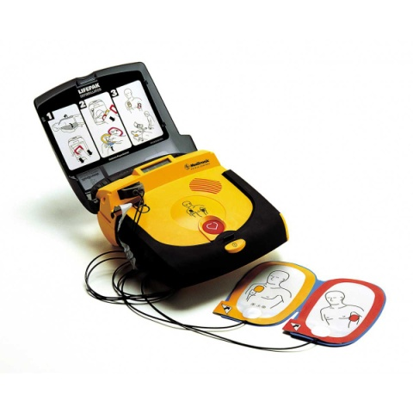
Verse 2
It's sad but true, there's many who,
Don't get the treatment that's needed.
But do not fear, if we are near,
You'll know the training's succeeded.
It's scary when there is a cardiac arrest,
But with us Heroes, well, you're dealing with the best.
Chorus
Heartbeats Heroes,
We're keeping an eye out for you.
Heartbeats Heroes,
We always know what we should do.
Don't despair, if things go wrong,
We'll be there, to help along.
Heartbeats Heroes,
Heroes are working for you.

Slide 6
Bridge
There will be others who should be there on the scene,
We'll need a defibrillator and a paramedic team.
Chorus
Heartbeats Heroes,
We're keeping an eye out for you.
Heartbeats Heroes,
We always know what we should do.
Don't despair, if things go wrong,
We'll be there, to help along.
Heartbeats Heroes,
Heroes are working for you. X3

Slide 7
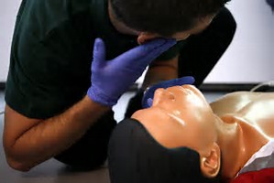
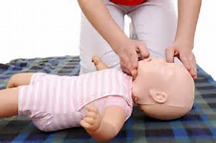
It’s CPR!
Verse
Someone's in trouble,
What should you do?
Check if they're breathing,
Or talking too.
Time to get help now,
Call 999.
Then roll your sleeves up,
Because it's time.
Just remember the things you were taught when the medics trained you,
There's no turning back, it's up to you!
999

Slide 8
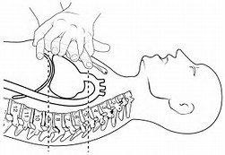
Chorus
Lock your hands, place on the chest,
Keep your arms straight, do not rest.
Get a rhythm deep and strong,
Keep it up no matter how long.
It's time to find out who you are,
Lock your hands, place on the chest,
Keep your arms straight, do not rest.
Get a rhythm deep and strong,
Keep it up no matter how long.
It's time to find out who you are,
It's CPR.
It's CPR.
It’s CPR

Slide 9
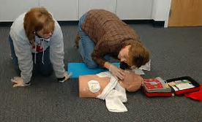
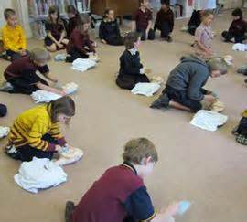
Keep That Heartbeat
Verse 1
Someone's in trouble,
What will you do?
Check if they're breathing,
Or talking too.
Time to get help now,
Call 999.
Roll both your sleeves up,
Because it's time.
Chorus 1
Remember all the things they said,
When the medics trained you,
Keep that heartbeat.
Now's the time for CPR,
It's up to you,
Remember keep that heartbeat.

Slide 10
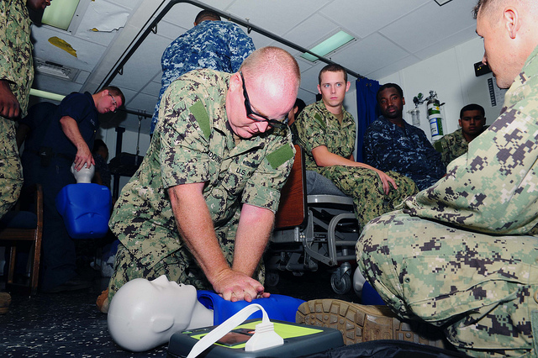
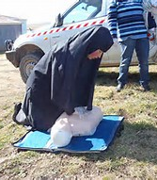
Verse 2
Lock hands together,
Place on the chest.
Keep both your arms straight,
You know the rest.
Get in a rhythm,
Deep ev'ry time.
Just keep on going,
You're doing fine.
Chorus 2
If you're tired swap with a friend,
It can't stop,
Remember keep that heartbeat.
Keep it up 'til help arrives,
Don't give up,
Remember keep that heartbeat.

Slide 11
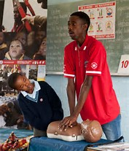
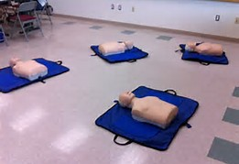
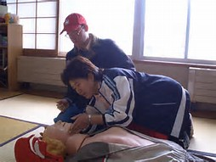
Verse 2
Lock hands together,
Place on the chest.
Keep both your arms straight,
You know the rest.
Get in a rhythm,
Deep ev'ry time.
Just keep on going,
You're doing fine.
Chorus 2
If you're tired swap with a friend,
It can't stop,
Remember keep that heartbeat.
Keep it up 'til help arrives,
Don't give up,
Remember keep that heartbeat. x3

Slide 12
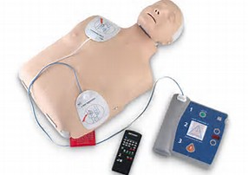
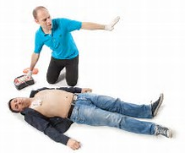
The Defibrillator Song
Verse
999
If there's a cardiac arrest then start your CPR,
Send for a defibrillator: shouldn't be too far.
Get out the paramedic crew by calling 999,
Follow the instructions, take a breath and take your time.
Remember what you're singing,
Then you'll know what you must do:
Chorus
Use the defibrillator and help someone get better,
It's a life-saving machine you know it's true.
There is no need to panic, it is all automatic,
The machine will do the tricky bit for you.
You open the kit and on the bare chest you stick on,
Both the sticky pads with wires going in.
Then let it do its magic so the outcome's not tragic,
The defibrillator's gonna help you win.

